Slide 1
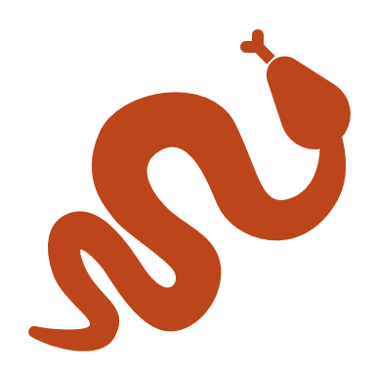
PYTHON DICTIONARY

Slide 2

OBJECTIVES
About Dictionaries.
Creating a dictionary.
Multi-dimensional dictionary.

Slide 3
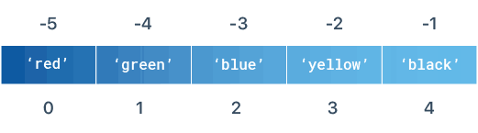

Slide 4
DICTIONARY
Stores data in key : value pair format.
Stores value like a map.
Unordered in nature.
Allow to grab element without knowing the index, just by the key.
A single value or element of a dictionary has two components namely a key and a value.
Dictionaries are very flexible in term of data- type they can store, they can store list, nested dictionaries and every other data type of python.

Slide 5
SYNTAX
Dict = { ‘key1’ : ‘value1’, ‘key2’ : ‘value2’}

Slide 6
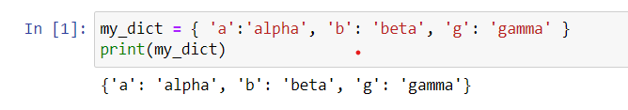
CREATING A DICTIONARY
To create a dictionary, we put sequence of element within curly braces separated by comma.
Each element has two component namely key and value, respectively.
The value can be retrieved from a dictionary using its key.
EXAMPLE :

Slide 7
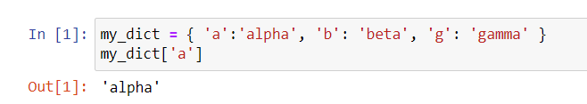
ACCESSING DICTIONARY
Accessing element of dictionary is same as accessing element of list, in case of dictionary instead of using index of the element we use the key to the value.
SYNTAX :
Dict_name [ key ]
EXAMPLE :

Slide 8
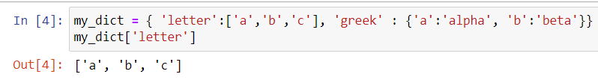
MULTI-DIMENSIONAL DICTIONARY
We can add different kind of data type like list as well as nested dictionaries within the dictionary.
EXAMPLE :

Slide 9

SUMMARY
A dictionary stores data in a key : value format.
A dictionary is ordered in nature.
The values are mapped to key.
Dictionary is very flexible in term of storing different data types.

